Slide 1
Physical Chemistry
Ying Hu
(Fifth edition)
Bilingual Program
版权所有：华东理工大学物理化学教研室

Slide 2
Part V Extension
Chapter 17
Electrochemistry
Bilingual Program
版权所有：华东理工大学物理化学教研室

Slide 3
Framework of the Chapter
Electrochemistry
Electrochemical Equilibria
Theories of Electrode
Solution Interface
Electrochemical Kinetics
Electromotive
Force
Outer Potential
Surface Potential
Inner Potential
Potential Relations among Reaction Rate, Current and Potential
电化学系统
的热力学
Thermodynamics
Surface Excess Charge Double-Layer Capacitance
Potential of
Cell Reaction
Polarization Phenomena Over-Potential
Potential of
Electrode Reaction
Electric Double-Layer Models
Outer Potential
Applications
Various Types
of Electrodes
Absolute Potential of Electrode Reaction
Transition-State Theory of Electrode Reactions
Calculations
Concentration Cell
Liquid-Junction Potential

Slide 4
17. Electrochemistry
    17.1 Introduction
    I. Electrochemical Equilibria
    17.2 Electromotive Force of Galvanic Cell and Interfacial Potential Difference
    17.3 Thermodynamics of Electrochemical Systems
    17.4 Potential and Standard Potential of Cell Reaction
    17.5 Potential and Standard Potential of Electrode Reaction
    17.6 Various Types of Electrodes and Standard Cell
    17.7 Electrochemical-Equilibrium Calculations
    17.8 Concentration Cell and Liquid-Junction Potential
    II. Theories of Electrode-Solution Interface
    17.9 Outer Potential, Surface Potential and Inner Potential
    17.10 Surface Excess Charge and Double-Layer Capacitance
    17.11 Electric Double-Layer Models and Outer Potential
    17.12 Absolute Potential of Electrode Reaction
    III. Electrochemical Kinetics
    17.13 Relations among Reaction Rate, Current and Potential
    17.14 Polarization Phenomena and Over-Potential
    17.15 Examples of Application
    17.16 Transition-State Theory of Electrode Reactions

Slide 5
17.1 Introduction
Electrochemistry and Electrochemical Reactions
Electrochemistry studies the chemical reactions taking place mainly on the electrode-solution interface and the corresponding phenomena accompanied.
Electrodes are usually metals or semiconductors.
Electrolyte Solutions include aqueous solutions, non-aqueous solutions, molten salts and solid electrolytes.
Electrode Reaction
The oxidation reaction or the reduction reaction taking place on the electrode-solution interface accompanied by the gain or loss of electrons.
Cell Reaction
The sum of various electrode reactions, changes on the interfaces and the transfer of ions in a cell.

Slide 6
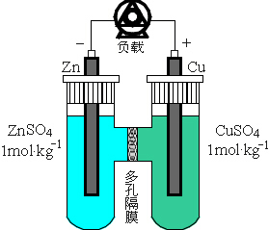
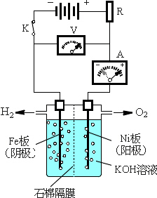
17.1 Introduction
Two types of cells
Galvanic Cell The electrical work (electric energy) is exported toward outside. (the electrode reactions are spontaneous)
Electrolytic Cell The electrical work from outside should be imported. (the electrode reactions are nonspontaneous)
The electrochemical reactions are redox reaction

Slide 7
17.1 Introduction
Electrode
Cathode
The cations approach to or the anions leave from. On a cathode, the reduction reaction carries out with electrons gained.
Anode
The anions approach to or the cations leave from. On an anode, the oxidation reaction with loss of electrons carries out.
Positive Electrode
The electrode with higher potential
Negative Electrode
The electrode with lower potential

Slide 8
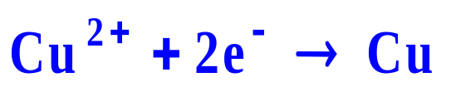
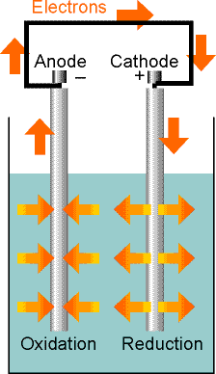
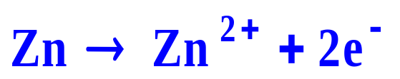
17.1 Introduction
In a galvanic cell, the cathode has a higher potential than the anode.
Cathode
Zn
Cu
Anode
Undergoing reduction, The species Cu²⁺ withdraws electrons from the cathode, and leaves a relative positive charge on it (corresponding to a higher potential). At the anode, oxidation results in the transfer of electrons to the electrode, so giving it a relative negative charge (corresponding to a lower potential).
CuSO₄

Slide 9
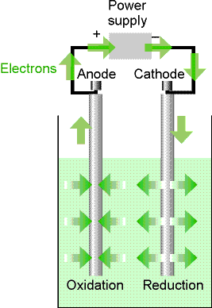

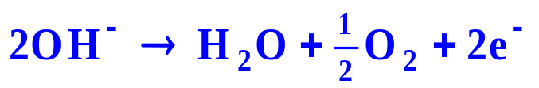
17.1 Introduction
In an electrolytic cell the anode must be made relatively positive to the cathode
Cathode
(Fe, negative)
Anode
(Ni, positive)
Ni
Fe
The cathode is still the location of reduction, but now there must be a supply of electrons to drive the reduction. And at the anode, electrons must be withdrawn from the species in that compartment because oxidation does not occur spontaneously.
KOH

Slide 10
17.1 Introduction
A-
C+
A+
C-
galvanic cell
electrolytic cell
spontaneous reaction
Nonspontaneous reaction
Redox reaction
Oxidation
Reduction
Anode
Cathode
Half reaction: Ox +ν e⁻ → Red

Slide 11
17.1 Introduction
The difference between electrochemical reactions and ordinary reactions
(1) Electrochemical reactions are carried out in cells accompanied by a charge flow
It is usually a redox reaction carried out in a cell but the reduction and the oxidation are performed separately on the electrode-solution interfaces of the cathode and the anode.

Slide 12
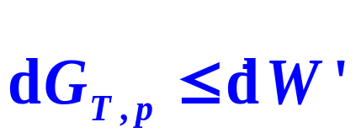
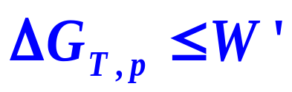
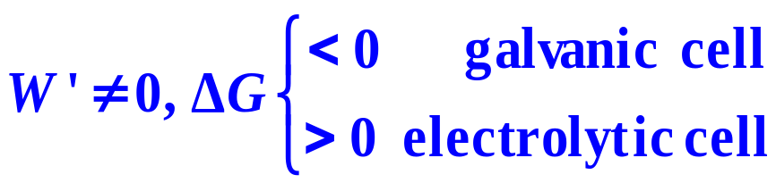

17.1 Introduction
The difference between electrochemical reactions and ordinary reactions
(2) Thermodynamic Characteristics of Electrochemical Reactions
or
Ordinary reactions
Electrochemical reactions
In electrochemical reactions, the change of Gibbs function is less than the electrical work exchanging between the system and the surroundings. In the reversible condition, ΔG_{T,p}=W_{R}′

Slide 13
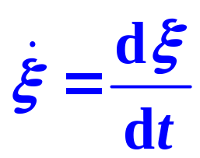
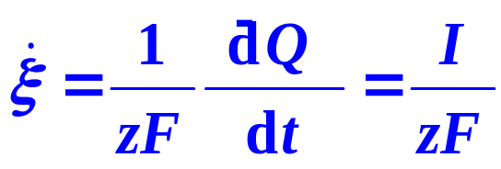
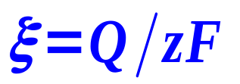
17.1 Introduction
The difference between Electrochemical Reactions and ordinary reactions
(3) Kinetic Characteristics of Electrochemical Reactions
the rate of conversion
the reaction extent
(Faraday's Law)
Reaction rates are strongly affected by the inner-potential difference in general or the terminal voltage for an electrolytic cell

Slide 14
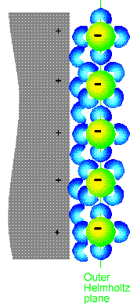

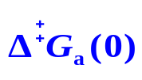
17.1 Introduction
The difference between Electrochemical Reactions and ordinary reactions
(3) Kinetic Characteristics of Electrochemical Reactions
Inner-Potential Difference of Electrode-Solution Interface (ESI)
The two sides of the electric double layer of the electrode interface.
The electrode reaction happens with the reaction barrier spans in.
The change of the inner-potential difference changes the height of the barrier and the activation energy, then affects the reaction rate.
For each 0.1V of depression, the rate increases about 7-fold.
α=1
OHP

Slide 15
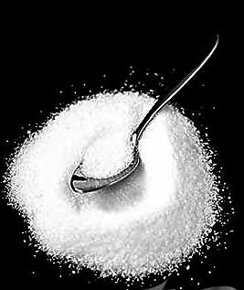
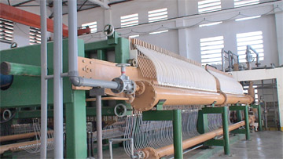
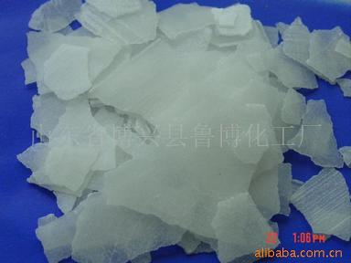
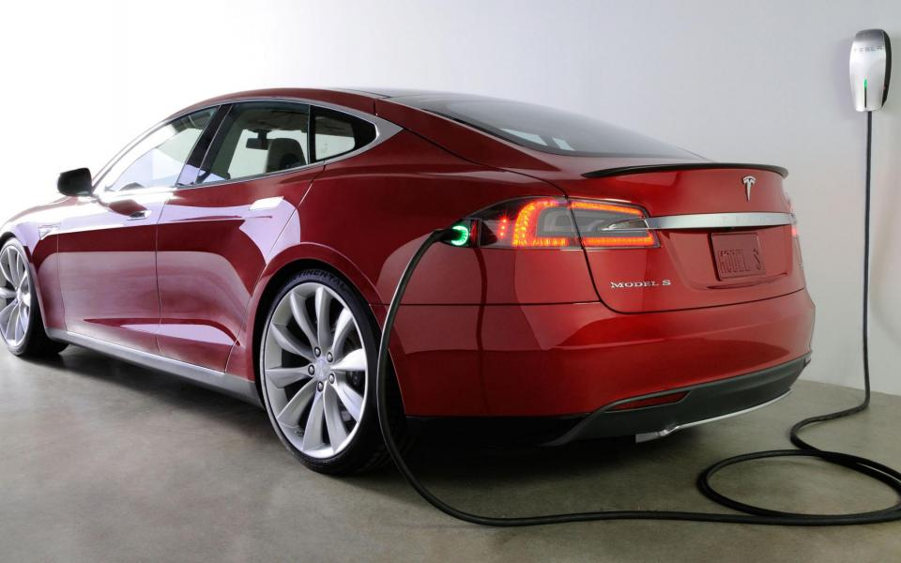
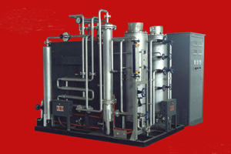
17.1 Introduction
Applications
Electro Synthesis
Electro Catalysis

Slide 16
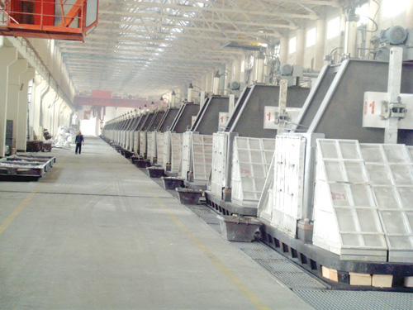
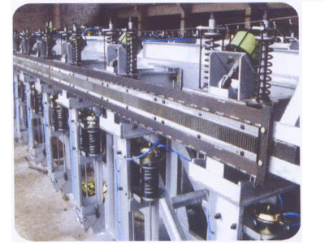

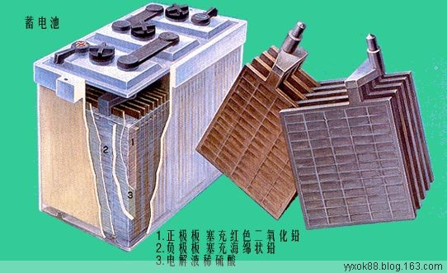
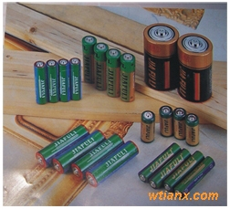
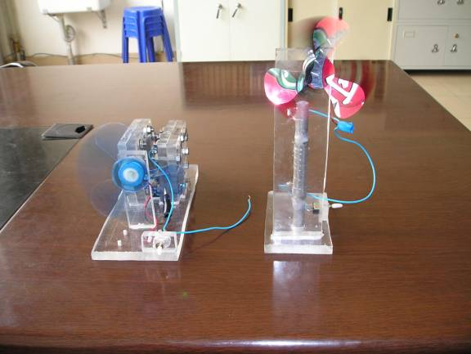
17.1 Introduction
Applications
Electrolytic Formation
Chemical Electric Source

Slide 17
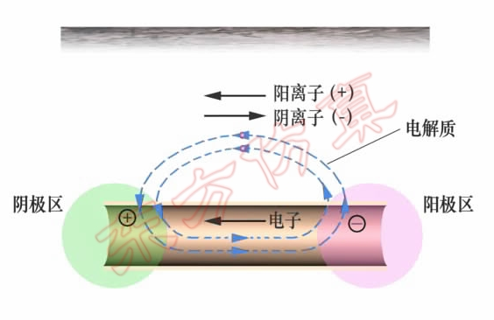
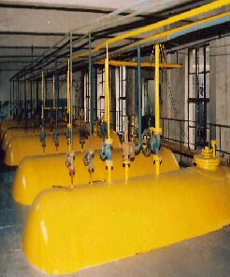

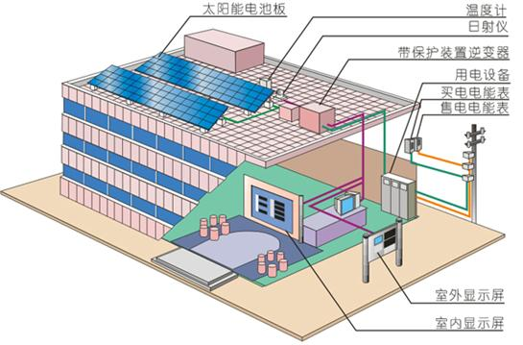
17.1 Introduction
Applications
Material Protection
Photo Electrochemistry

Slide 18
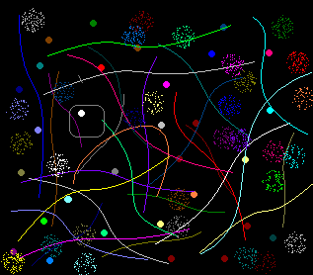
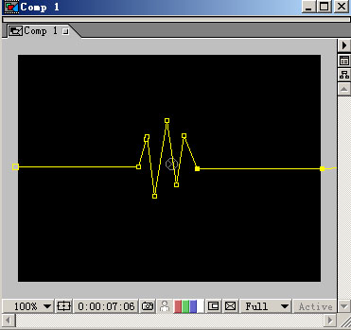

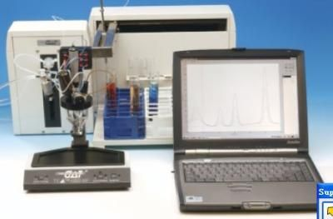
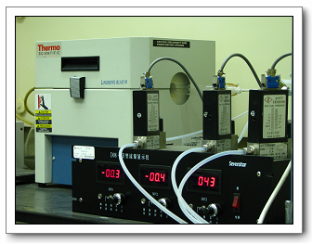
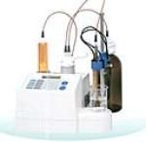
17.1 Introduction
Applications
Bio-Electrochemistry
520
Electrochemical Analysis

Slide 19
I. Electrochemical Equilibria
Bilingual Program
版权所有：华东理工大学物理化学教研室

Slide 20
16. Electrolyte Solutions
I. Electrochemical Equilibria
    17.2 Electromotive Force of Galvanic Cell and Interfacial Potential Difference
    17.3 Thermodynamics of Electrochemical Systems
    17.4 Potential and Standard Potential of Cell Reaction
    17.5 Potential and Standard Potential of Electrode Reaction
    17.6 Various Types of Electrodes and Standard Cell
    17.7 Electrochemical-Equilibrium Calculations
    17.8 Concentration Cell and Liquid-Junction Potential

Slide 21
17.2 Electromotive Force of Galvanic Cell and Interfacial Potential Difference
1. Conventions for Writing Galvanic Cell
Take the Daniel cell for example
The arranging sequence of various substances in a cell should be:
The electric current flows from the left to the right passing through each phase boundary during discharge.
The negative electrode must be written on the left,
“ | ” --- a stable boundary
“┆” --- an unstable boundary between the mixable liquids
“ || ” --- an interface for which it is assumed that the junction potential has been eliminated.

Slide 22
17.2 Electromotive Force of Galvanic Cell and Interfacial Potential Difference
1. Conventions for Writing Galvanic Cell
The cell reaction is written on the assumption that the right-hand electrode is the cathode,
If the reduction is taking place in the right-hand, then the cell reaction is spontaneous as written.
If the left-hand electrode turns out to be the cathode, then the reverse of the cell reaction is spontaneous.
The inner potentials of various phases are marked with a symbol of φ, which are the electrostatic potentials in the interior of various phases

Slide 23
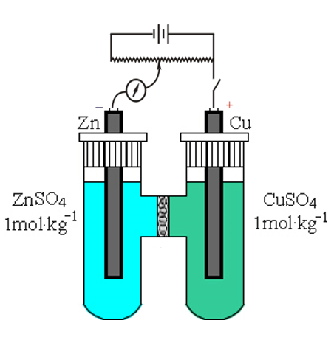
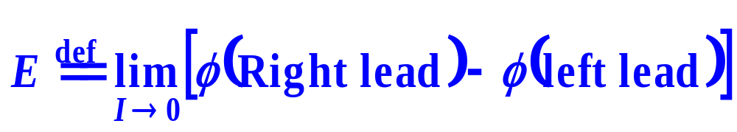
17.2 Electromotive Force of Galvanic Cell and Interfacial Potential Difference
2. Electromotive Force of Galvanic Cell
The inner-potential difference between the metal lead connecting the electrode (positive) on the right and the electrode (negative) on the left is called the cell potential.
When the current is zero (reaches equilibrium), the cell potential of a galvanic cell is called the electromotive force (abbreviated as EMF) with a symbol of E,
Because of the existence of EMF, the galvanic cell can produce electrical work.

Slide 24
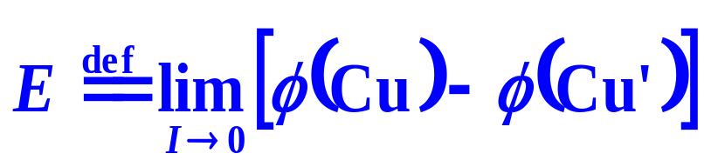

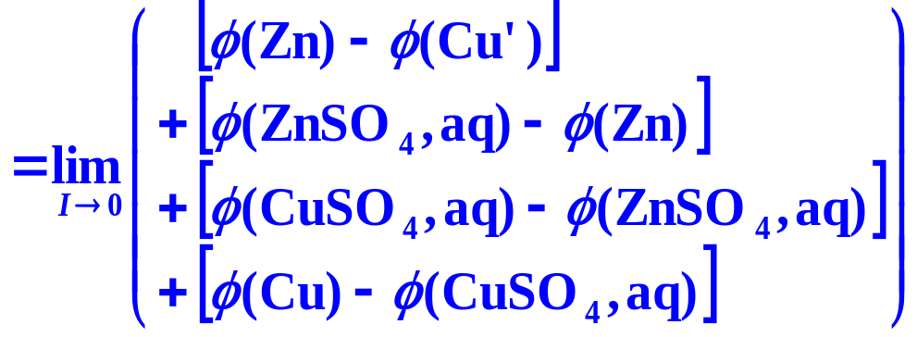



17.2 Electromotive Force of Galvanic Cell and Interfacial Potential Difference
3. Interfacial Inner-Potential Difference
Various Interfacial Inner-Potential Differences and Electromotive Force

Slide 25
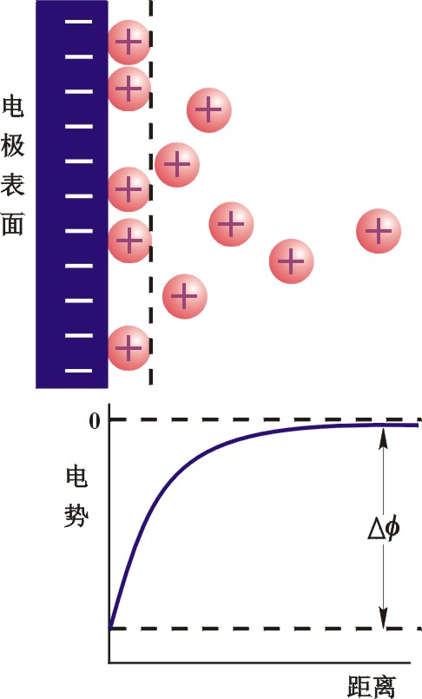

17.2 Electromotive Force of Galvanic Cell and Interfacial Potential Difference
3. Interfacial Inner-Potential Difference
Interfacial Inner-Potential Difference between Electrode and Solution
Diffusive electric double- layer
A compact layer close to the interface with a thickness of an order of magnitude of 0.1nm
A diffusive layer dispersed toward the solution.
Electrode
An inner-potential difference is formed between the electrode and the solution
Inner Potential
Distance

Slide 26
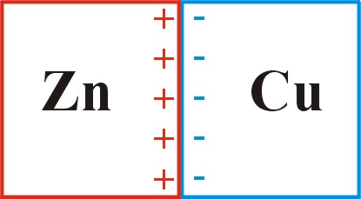
17.2 Electromotive Force of Galvanic Cell and Interfacial Potential Difference
3. Interfacial Inner-Potential Difference
Contact Potential
There is also an inner-potential difference existing on the interface of a contact between the electrode and the lead such as Cu’|Zn. It is usually small and can be neglected. However, it must be taken into account in accurate measurements.
Liquid-Junction Potential
On the interface between two solutions containing different solutes or the same solute but with different concentrations, a tiny inner-potential difference called the liquid-junction potential or the diffusion potential

Slide 27
17.2 Electromotive Force of Galvanic Cell and Interfacial Potential Difference
3. Interfacial Inner-Potential Difference
Liquid-Junction Potential
Different electrolytes
Different concentrations
H⁺
H⁺
Caused by different migration speed of ions
HCl
KCl
HCl
HCl
K⁺
Cl⁻
the liquid-junction potential is usually ≤ 0.03V, it can not be neglected in accurate measurements.
-
-
-
-
-
-
-
-
-
+
+
+
+
+
+
+
+
+
-
-
-
-
-
-
-
-
-
+
+
+
+
+
+
+
+
+
H⁺
H⁺
HCl
KCl
HCl
HCl
K⁺
Cl⁻

Slide 28
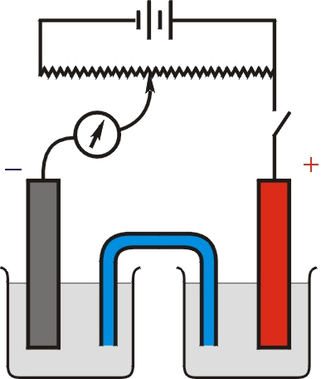
17.2 Electromotive Force of Galvanic Cell and Interfacial Potential Difference
3. Interfacial Inner-Potential Difference
Salt Bridge
The salt bridge is usually a U-type glass tube filled with saturated KCl or NH₄NO₃ solution. Due to the high concentration of KCl, the diffusion of K⁺ and Cl⁻ toward the solution is predominating, and the two ions have similar migration speed.
Salt Bridge
The usage of the salt bridge can always diminish the liquid-junction potential

Slide 29
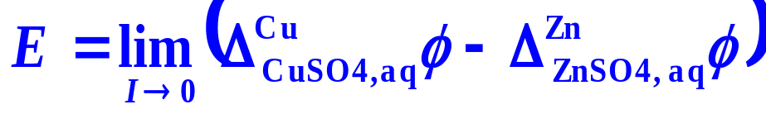
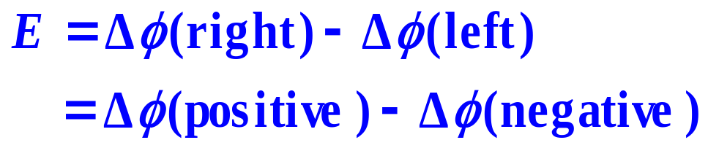
17.2 Electromotive Force of Galvanic Cell and Interfacial Potential Difference
3. Interfacial Inner-Potential Difference
Approximate Relation between Electromotive Force and Interfacial Inner-Potential Difference

Slide 30
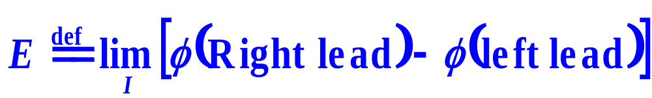
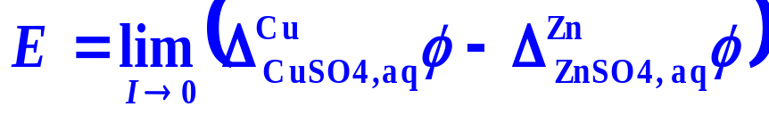

17.2 Electromotive Force of Galvanic Cell and Interfacial Potential Difference
Summary
Inner potential
Cell potential
Electromotive Force
E
When I = 0
Contact Potential
Liquid-Junction Potential
Different electrolytes
Different concentrations
Salt bridge

Slide 31
17.3 Thermodynamics of Electrochemical Systems
3. Electrochemical Equilibria
Electrochemical Equilibrim State
By using the compensation method, when the output voltage of the potentiometer is equal to the electromotive force of the cell but with the opposite direction, the galvanometer is zero, the state of the cell keeps unchanged for a long period that can be considered as in electrochemical equilibrium.
Besides constant temperature, pressure and concentrations of various components, a stable inner-potential difference, i.e., an electromotive force E exists between the two electrodes of the cell.

Slide 32
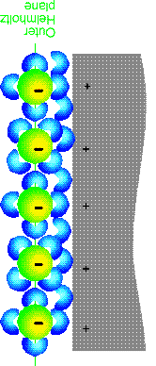




17.3 Thermodynamics of Electrochemical Systems
1. Thermodynamic Fundamental Equations of Electrochemical Systems
A heterogeneous system with changeable compositions, each phase of it possesses a certain inner potential.
The electrochemical potential
z_{i}
z_{i}

Slide 33
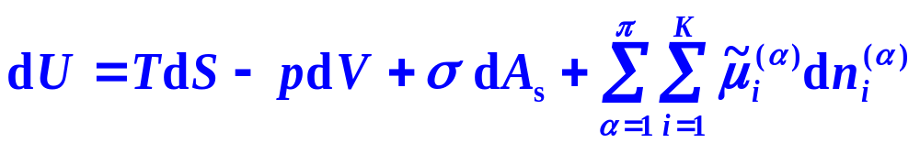
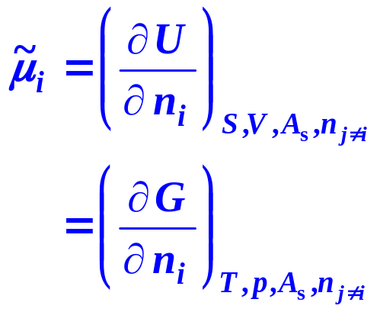
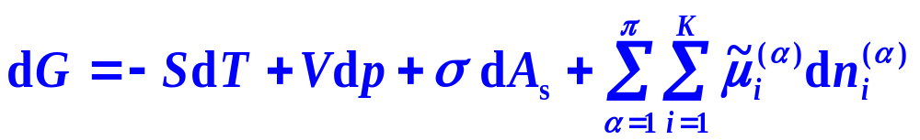
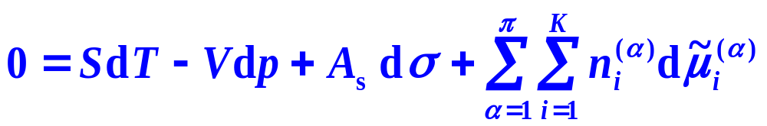
17.3 Thermodynamics of Electrochemical Systems
1. Thermodynamic Fundamental Equations of Electrochemical Systems
The electrochemical potential
The thermodynamic fundamental equations

Slide 34
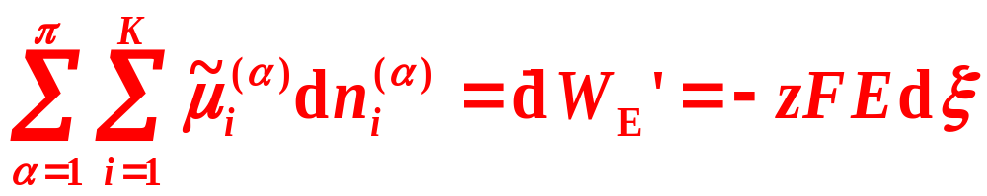


17.3 Thermodynamics of Electrochemical Systems
3. Electrochemical Equilibria
Electrochemical Equilibrium Criterion
Phase-Equilibrium Criterion

Slide 35
16. Electrolyte Solutions
I. Electrochemical Equilibria
    17.2 Electromotive Force of Galvanic Cell and Interfacial
    Potential Difference
    17.3 Thermodynamics of Electrochemical Systems
    17.4 Potential and Standard Potential of Cell Reaction
    17.5 Potential and Standard Potential of Electrode Reaction
    17.6 Various Types of Electrodes and Standard Cell
    17.7 Electrochemical-Equilibrium Calculations
    17.8 Concentration Cell and Liquid-Junction Potential

Slide 36










17.4 Potential and Standard Potential of Cell Reaction
1. Potential of Cell Reaction
Derivation
the liquid-junction potential is eliminated

Slide 37

17.4 Potential and Standard Potential of Cell Reaction
1. Potential of Cell Reaction
Definition
E is solely determined by the reaction, i.e., by the chemical potentials of various substances participating in the reaction
Only approximately, E can be regarded as the electromotive force
The cell potential is a potential in either equilibrium or non-equilibrium condition. The potential of cell reaction or the electromotive force of a cell is the potential in equilibrium condition when the current is zero.
A perfect writing should point out the reaction and the concentrations of various substances.
E is an intensive property, Δ_{r}G_{m} depends on the writing of the cell reaction, and they are unified by the reaction charge number.

Slide 38

17.4 Potential and Standard Potential of Cell Reaction
2. Standard Potential of Cell Reaction
Definition
The standard states selected are usually as the solid, liquid pure substance and the gaseous pure substance in an ideal-gas state, and the pure water, at the system temperature and a pressure of (0.1 MPa). For ions, the solute ion in an ideal dilute solution of =1mol⋅kg⁻¹ or =1mol⋅dm⁻³ is adopted.

Slide 39





17.4 Potential and Standard Potential of Cell Reaction
3. Nernst Equation
Derivation

Slide 40


17.4 Potential and Standard Potential of Cell Reaction
3. Nernst Equation
For the reaction of a Daniel cell,
Because Zn and Cu are pure substances, a_{Zn}=a_{Cu}=1,

